Slide 1


Part I: Introduction
Dimitris SACHARIDIS
2023-2024

Slide 2















Business processes
Organisation
Function A
Function B
Function C
Financial
Business Process
Human Resources
Business Process
Customers
Technology
Business Process
Materials
2

Slide 3
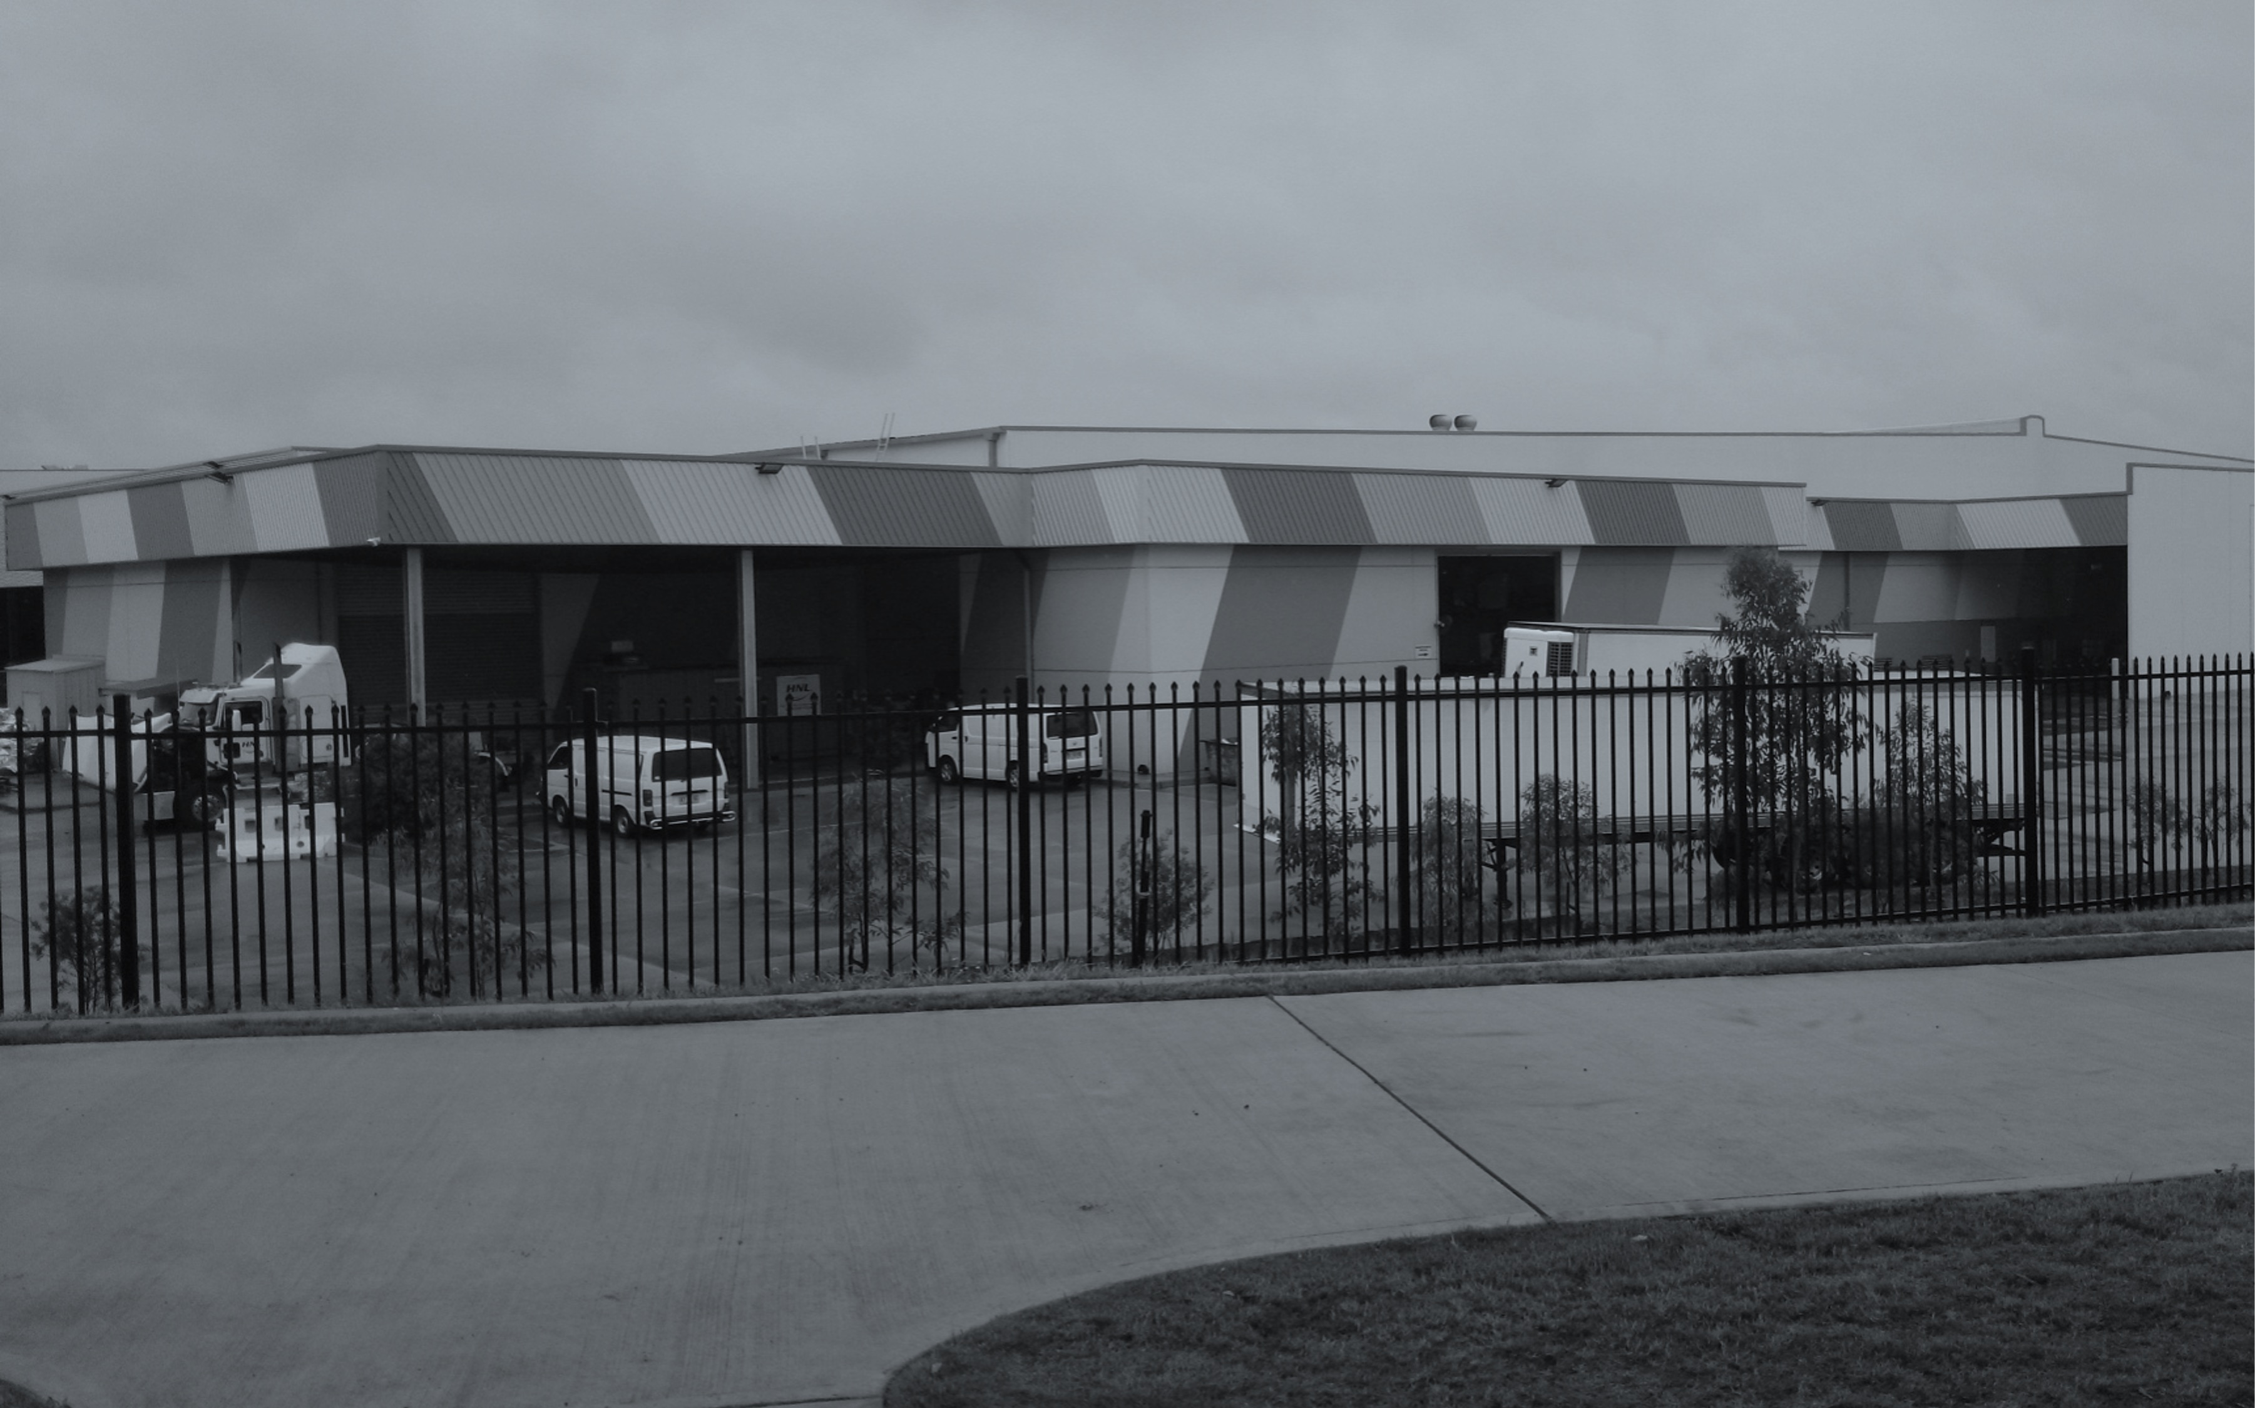





















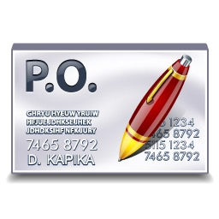



















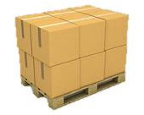
Check & confirm PO
PO
received
Package products
Load truck
Notify shipment
Issue invoice
Match payment
Payment made
PO
issued
Obtain PO
confirm.
Schedule delivery
Unload truck
Issue delivery receipt
Check invoice
Schedule payment
Goods arrived
3

Slide 4
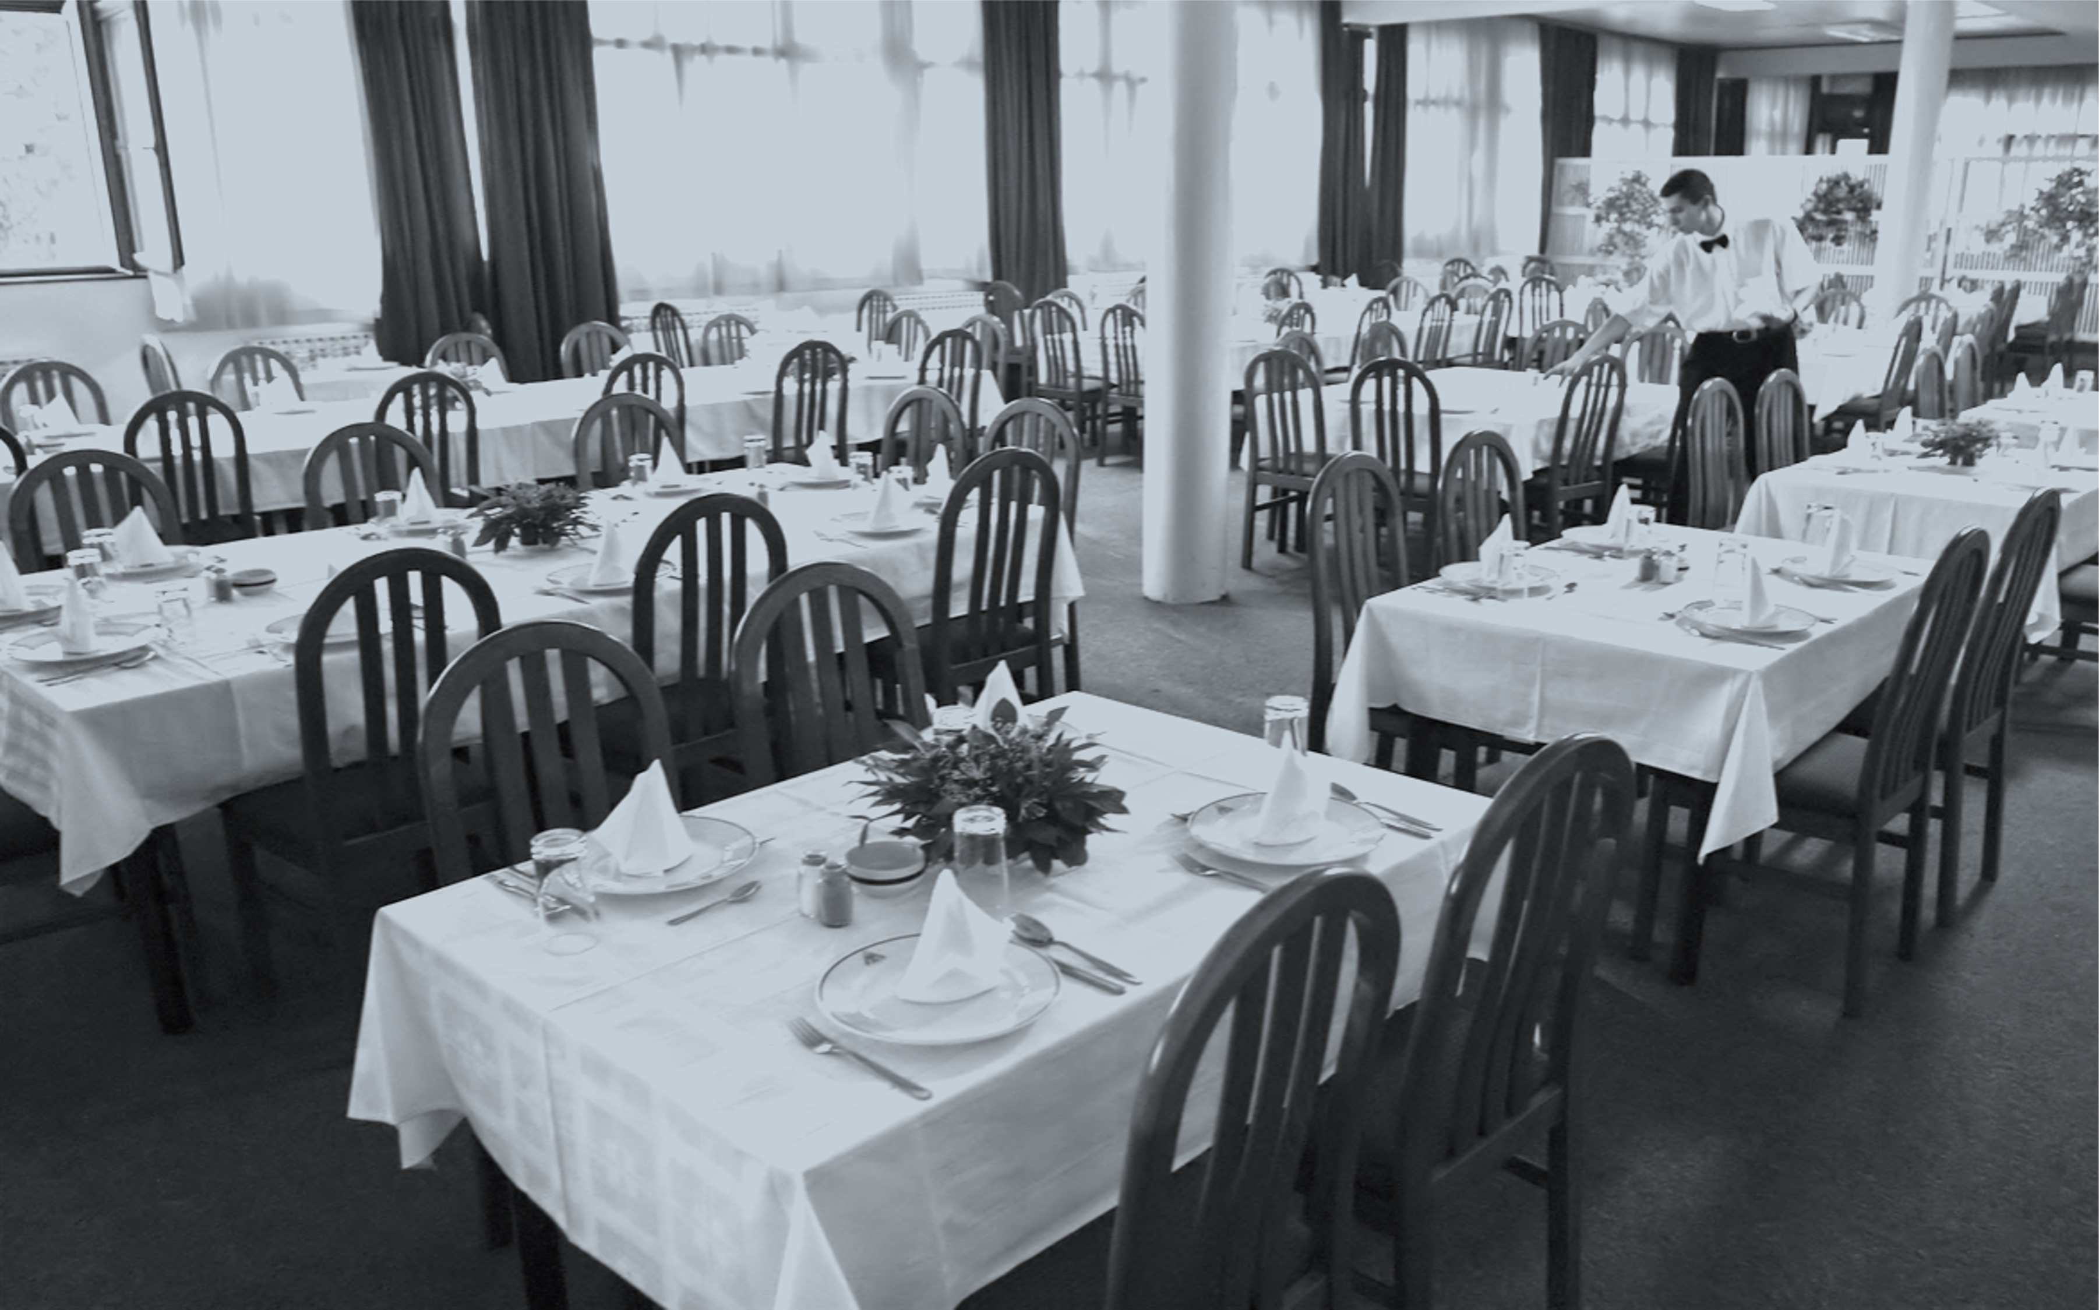





































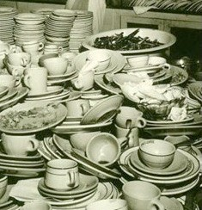

Customer arrived
Greet & seat
Take order
Bring menu
Serve meal
Present bill
Issue invoice
Customer paid
Kitchen is dirty
Load dish- washer
Clean kitchen surfaces
Brush grills
Sweep & mop
Unload dish- washer
Kitchen is clean
Collect laundry

Slide 5
A business process is…
a chain of events, activities and decisions
...involving a number of actors and objects,
…triggered by a need
and leading to an outcome that is of value to a customer.
Examples:
Quote-to-order
Starts when supplier received Request for Quote(RFQ) from customer and ends when the customer purchase order based on received quote. The combination of quote-to-order and order-to-cash is quote-to-cash
Order-to-Cash
Starts when customer places an order and ends when order placed has been received and payment has been paid
Procure-to-Pay (aka Purchase-to-Pay)
Starts when someone from company determines that given product needs to be purchased and ends when product has been delivered and payment has been made
Application-to-Approval
Starts when someone applies for benefit or privilege and ends when benefit or privilege has either granted or denied
Issue-to-Resolution
Starts when customer raises some issue and ends when both customer and supplier agrees that the issue has been resolved

Slide 6




“My washing machine doesn’t work…”
Negative outcomes (value-reducing):
Fault not repaired in a timely manner
Fault repaired but customer pays more than expected
Positive outcomes (value-adding):
Fault repaired immediately with minor intervention
Fault repaired, covered by warranty
Insurance Company
Call Centre
Technician
Customer
Customer
Customer
Parts Store
Service Dispatch Centre
VALUE
issue-to-resolution process

Slide 7
Your turn
Think of an organization and a process in this organization:
Is it order-to-cash, procure-to-pay, application-to-approval, issue-to-resolution…
Who is/are the customer(s)?
What value does this process deliver to its customer?
Who are the key actors of the process?
List at least 3 outcomes of the process.

Slide 8




11

Slide 9





























Improving Performance (Rummler’s Framework)
Business Environment
Economy Regulatory Culture
Assets & Resources
Organisation
Performance Planning
Performance Management
Stakeholders
Financial
Human Resources
Function A
Function B
Function C
Busi
ness Pro
cess
Technology
Customers
Materials
Business Process
Competitors
12

Slide 10
Process performance
If you had to choose between two services, you would typically choose the one that is:
Faster
Cheaper
Better
Three dimensions of process performance
Time
Cost
Quality

Slide 11




















Improving process performance
Customer arrived
Greet & seat
Take order
Bring menu
Serve meal
Present bill
Issue invoice
Customer paid

Slide 12








Business Process Management (BPM)
Body of principles, methods and tools to design, analyze, execute and monitor business processes, with the aim of improving their performance.
IT systems
Customers
Employees
Business Processes
Data
Trading Partners
IT infrastructure
Suppliers

Slide 13

Why BPM?
“The first rule of any technology used in a business is that automation applied to an efficient operation will magnify the efficiency.
The second is that automation applied to an inefficient operation will magnify the inefficiency.”
Bill Gates

Slide 14


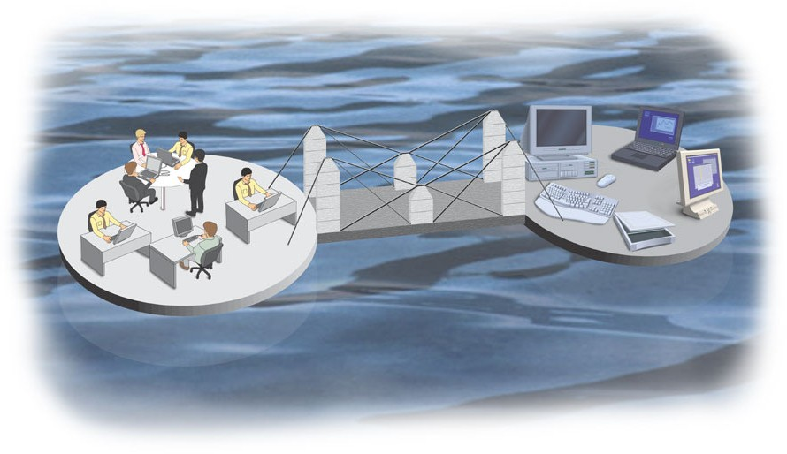
In other words…
Information Technology
Yields
Business Value
Enables
Yields
Process Change
Index Group (1982)

Slide 15






The BPM lifecycle
Select process that needs to be improved
Which process to improve?
When does the problem start?
In which scenarios do the problem start?
Will it be resolved if?
This phase leads to process architecture which is the collection of interlinked process that an organization performs to achieve its mission.
Process identification
Process architecture
Once BPM team identifies what are they going to deal with, they need to understand whole process in detail.
Outcome of this phase is as-is process model, which provides understanding of how work is done.
Conformance and performance insights
Process discovery
As-is process model
Executable process model put into execution is monitored
Process monitoring and controlling
Identify, classify and understand main cause of negative outcomes
Analysts find way to minimize them
Process analysis
Executable process model
Insights on weaknesses and their impact
Process implementation
Process redesign
Once cause is problem is understood and potential remedies are understood, analysts can propose redesigned version of process
Redesigned process is implemented
So that to-be process model is put into execution
To-be process model
22

Slide 16
Process identification steps
Designation step
Enumerate main processes
Determine process scope
Process Architecture
Prioritization step (aka Process selection)
Prioritize processes based on:
Importance
Health
Feasibility
Prioritized Process Portfolio
After Davenport (1993)

Slide 17
Example: process architecture
Wholesaler
Strategic Management
Logistics
Management
Suppliers
Management
Warehouse
Demand
Management
Management
Management processes
Core processes
Direct
procurement
Sales
Distribution
Marketing
Service
Support processes
Finance
Indirect
procurement
IT
HR

Slide 18

Prioritization (aka Process Selection)
Importance
Which processes have greatest impact on the organization‘s strategic objectives?
Health (or Dysfunction)
Which processes are in deepest trouble?
Feasibility
Which processes are most susceptible to successful process management?
Prioritized process portfolio
Hammer, Champy (1993)

Slide 19
Example: prioritized process portfolio
Financial institution
Short-term action
High
Rating
Feasibility
Low
Loan controlling
Contract preparation
Loan decision
Medium
Importance
Loan market evaluation
High
Handling of payments
Loan planning
Loan application
Low
Poor
Possible
Health
Strategic fit?
Good

Slide 20
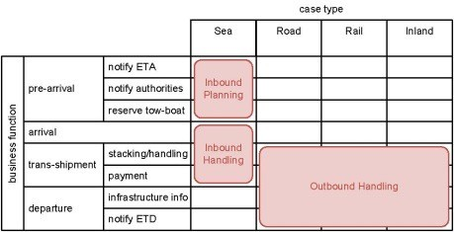
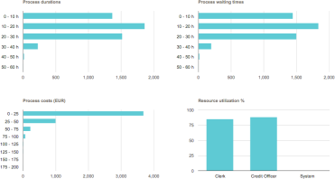
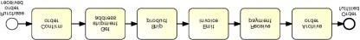
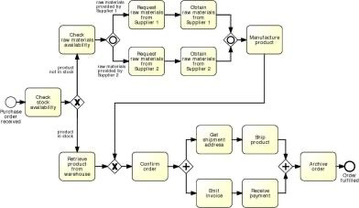
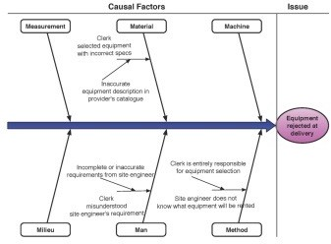
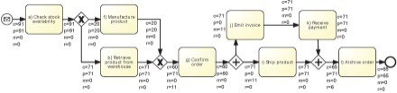
The BPM lifecycle
Process identification
Process architecture
Conformance and performance insights
Process discovery
As-is process model
Process monitoring and controlling
Process analysis
Executable process model
Insights on weaknesses and their impact
Process implementation
Process redesign
To-be process model

Slide 21
Business process model
Invoice handling example
Finance Department
ERP
Invoice
Report
Invoice
Enter Invoice Details
Check Invoice Mismatches
no mismatches
Post Invoice
Invoice received
Invoice posted
Invoice DB
Invoice
Senior Finance Officer
mismatch exists
Block Invoice
Invoice blocked

Slide 22
The BPM lifecycle
Process identification
Process architecture
Conformance and performance insights
Process discovery
As-is process model
Process monitoring and controlling
Process analysis
Executable process model
Insights on weaknesses and their impact
Process implementation
Process redesign
To-be process model

Slide 23

Qualitative process analysis
Root-cause analysis example
Causal Factors
Measurement Material
Issue
Machine
Clerk
selected equipment with incorrect specs
The system does not keep the site engineer informed
Inaccurate equipment description in
provider's catalogue
Equipment rejected at delivery
Incomplete or inaccurate requirements from site engineer
Clerk is entirely responsible for equipment selection
Clerk
misunderstood
site engineer's requireme^{nt}
Site engineer does not validate the choice of equipment
Milieu
Man
Method
30

Slide 24

Quantitative process analysis
Process simulation example

Slide 25
The BPM lifecycle
Process identification
Process architecture
Conformance and performance insights
Process discovery
As-is process model
Process monitoring and controlling
Process analysis
Executable process model
Insights on weaknesses and their impact
Process implementation
Process redesign
To-be process model

Slide 26
Process redesign
AS-IS process model
TO-BE process model
Cost
Time
Flexibility
Quality

Slide 27





The BPM lifecycle
Process identification
Process architecture
Conformance and performance insights
Process discovery
As-is process model
Process monitoring and controlling
Process analysis
Executable process model
Insights on weaknesses and their impact
Process implementation
Process redesign
To-be process model

Slide 28



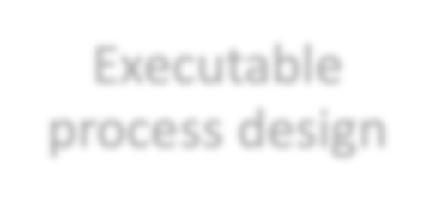



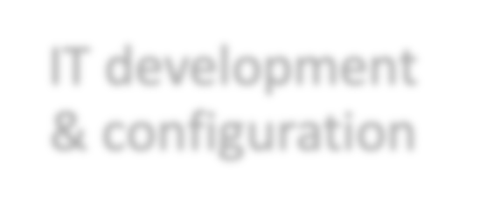









Process implementation
Process automation
Process change management
Executable process design
Job redesign
IT development & configuration
Training
Performance
management plan
Testing
...
….

Slide 29
The BPM lifecycle
Process identification
Process architecture
Conformance and performance insights
Process discovery
As-is process model
Process monitoring and controlling
Process analysis
Executable process model
Insights on weaknesses and their impact
Process implementation
Process redesign
To-be process model

Slide 30


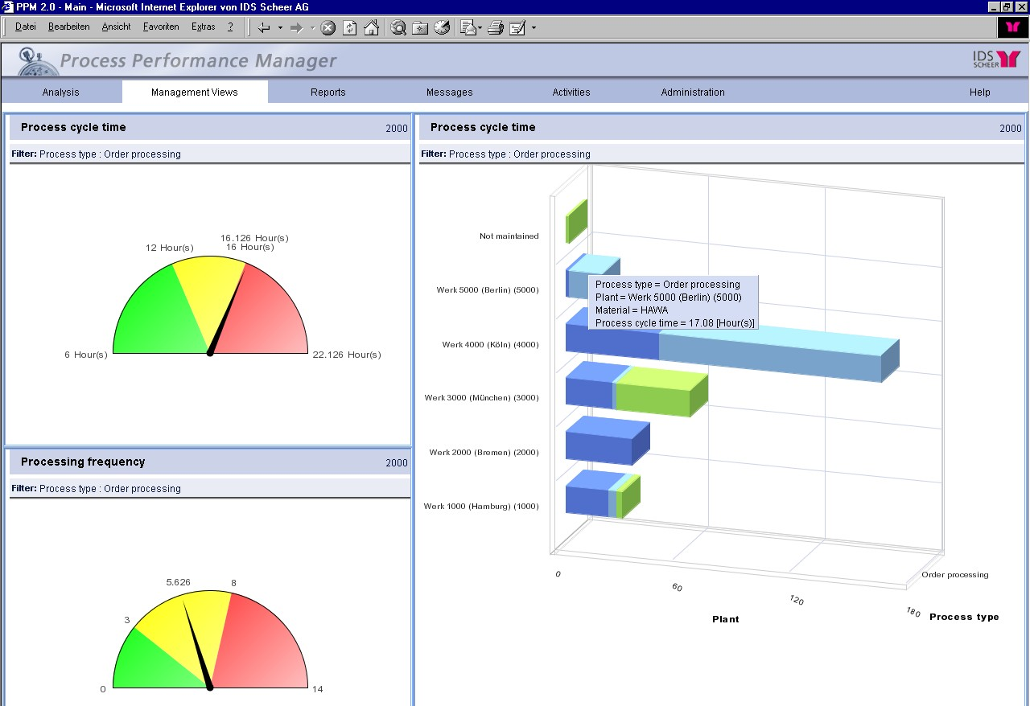



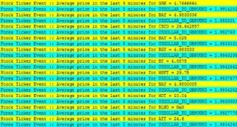

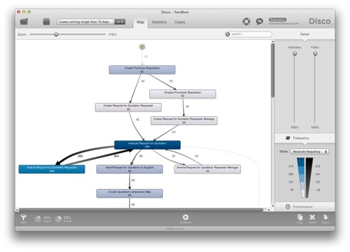
Process monitoring
Dashboards, alerts & reports
Event stream
Model-based analytics (p. mining)
DB logs

Slide 31
The BPM lifecycle
Process identification
Process architecture
Conformance and performance insights
Process discovery
As-is process model
Process monitoring and controlling
Process analysis
Executable process model
Insights on weaknesses and their impact
Process implementation
Process redesign
To-be process model

Slide 32

















The BPM lifecycle
Process identification
Process
discovery
Process monitoring and controlling
Gover- nance
Strategy
Process
analysis
Culture
Process
implementation
Process
redesign

Slide 33

Process identification
What?
Identify an organization’s business processes
Prioritize their management based on certain criteria
Why?
Understand the organization
Maximize value of BPM projects

Slide 34
Process identification steps
Designation step
Enumerate main processes
Determine process scope
Process Architecture
Prioritization step (aka Process selection)
Prioritize processes based on:
Importance
Health
Feasibility
Prioritized Process Portfolio
After Davenport (1993)

Slide 35
Process Enumeration
“Most businesses have just three core processes:
Sell stuff
Deliver stuff
Making sure you have stuff to sell and deliver”
Geary Rummler

Slide 36






Porter: Types of processes
Management Processes
Customers / Stakeholders
Suppliers / Partners
Core Processes
Support Processes
After Michael Porter (1985)

Slide 37
Example: core, support and management processes
Wholesaler
Core processes
Sales (lead-to-quote, quote-to-order, order-to-cash)
Purchase-to-Pay (direct procurement, e.g. supplies replenishment)
…
Support processes
Purchase-to-pay (indirect procurement, e.g. parts replenishment, operational resources replenishment…)
HR (policies update, recruitment, induction, probation…)
…
Management processes
Suppliers management (suppliers planning, suppliers acquisition…)
Logistics management (logistics planning, logistics controlling…)
…

Slide 38
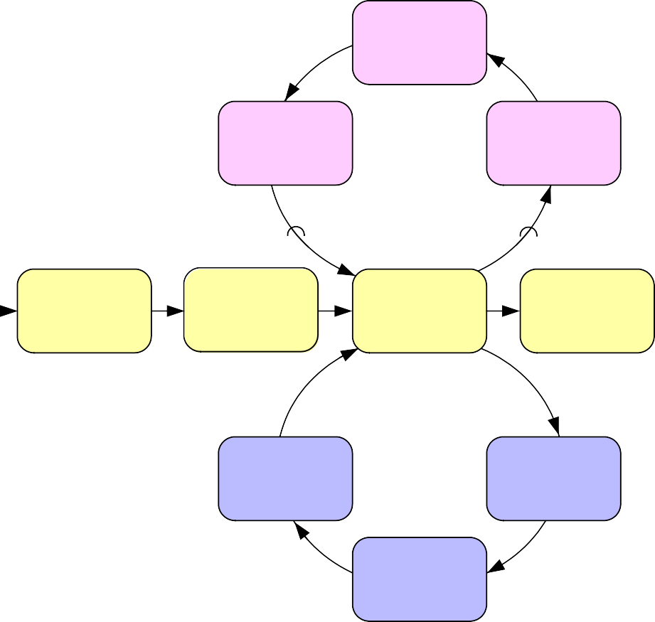
Relations between core, support, mgt processes
Management processes provide direction, rules and practices
Establish Sourcing
Procedure
Sign Contracts
Plan Vendors Process
Evaluate Vendors
Core processes generate value as they are directly linked to external customers
Fill Order Process
Receive Order
Approve Order
Fill Order
Deliver
Order
Reorder Supplies Process
Support processes provide resources to be used by other processes
Stock Supplies
Order Supplies
Receive Supplies

Slide 39
Example: process architecture
Wholesaler
Strategic Management
Logistics
Management
Suppliers
Management
Warehouse
Demand
Management
Management
Process group
Management processes
Direct
procurement
Sales
Distribution
Marketing
Service
Core processes
Finance
Indirect
procurement
IT
HR
Support processes

Slide 40
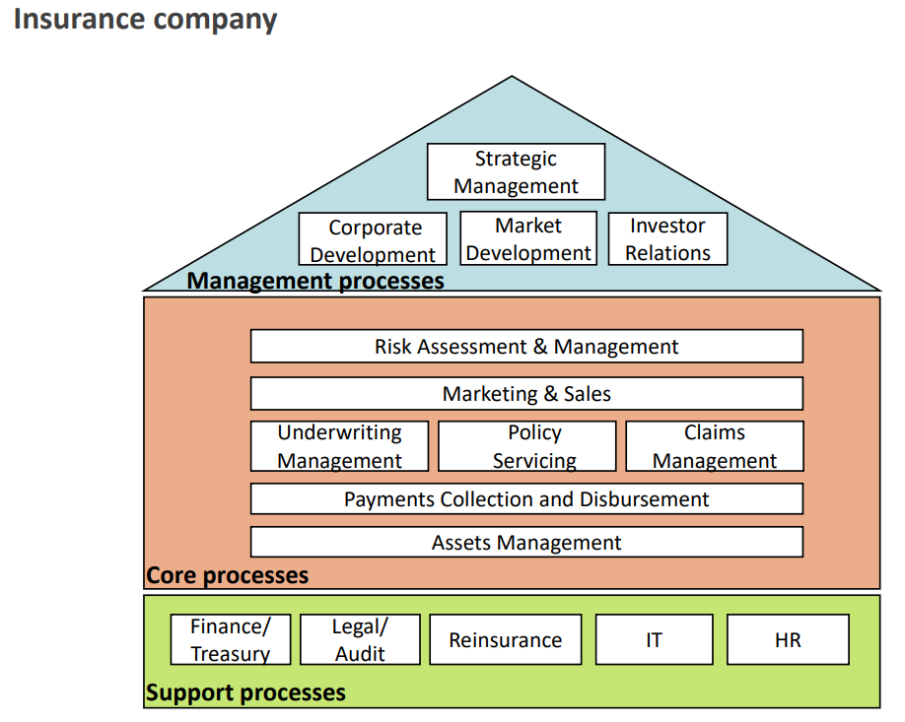
Example: process architecture
Insurance company

Slide 41
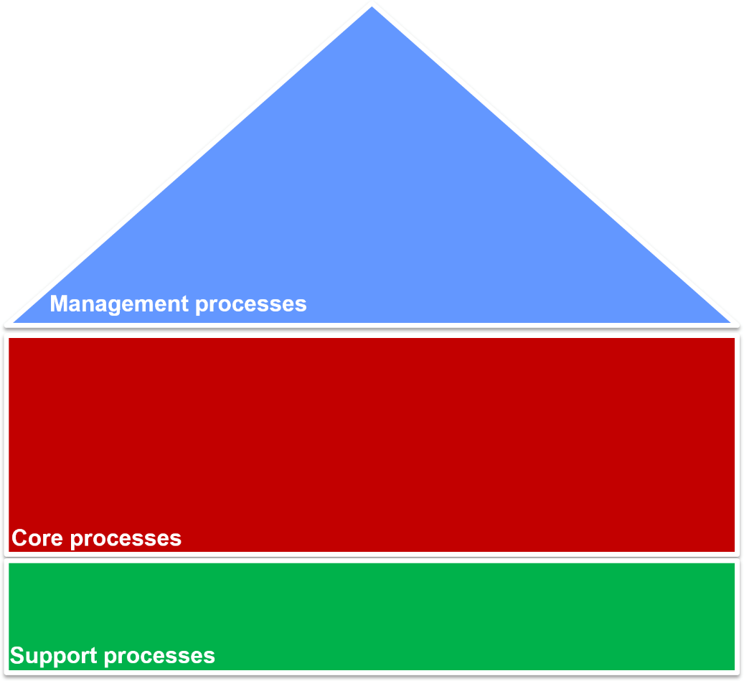
Exercise: classify by process type
These groups of processes are typically performed at a university. Categorize each process group as core, support or management
Sport services
HR
Indirect procurement
Strategic Management
Teaching award courses
IP
Management
Marketing
Course Management
Additional services mgt
Language training
Admission
IT
Market management
Teaching professional courses

Slide 42
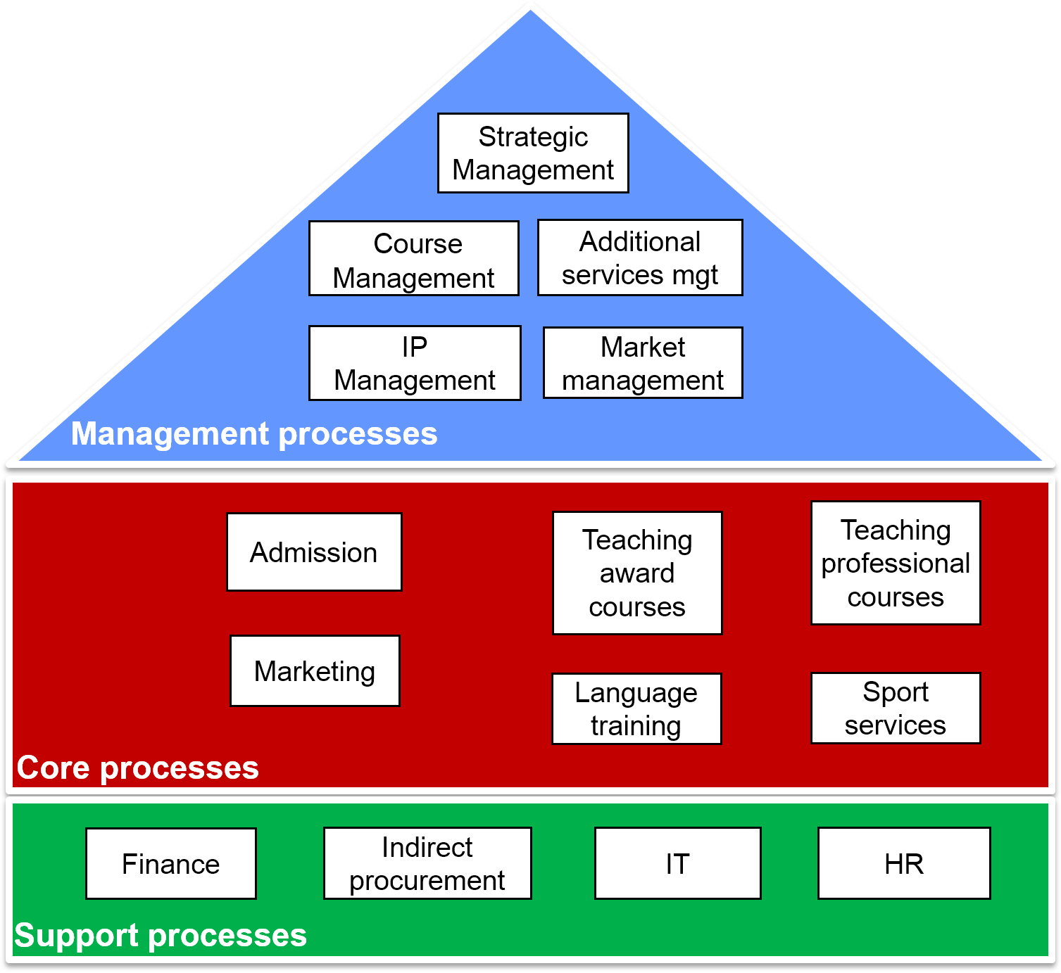
Solution: identify process types

Slide 43
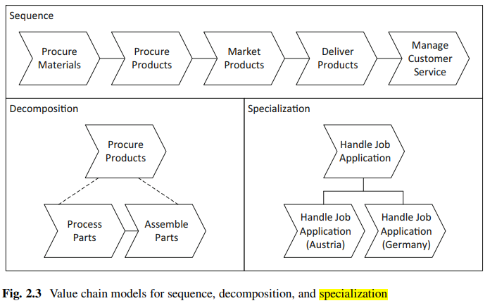
Process scoping
Processes are interdependent → insights into interrelations required
Specialization: general – special product/service
Horizontal: upstream – downstream processes and their value chains
Vertical: main processes – sub-processes
For a process architecture, there are 3 types of relationship:
Sequence, Decomposition and Specialization
Sequence
- Called horizontal relationship
- Output of one process is input to another process
Decomposition
- This relationship describes that one process has been decomposed into one or more detailed sub-processes
Specialization
- This relationship shows that there exists several variants of a generic process
- Ex: generic process of handling job applications in a multi-national company
- There may be different way of handling job application in Belgium and in Germany

Slide 44
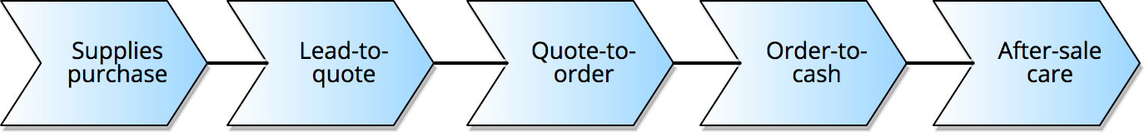
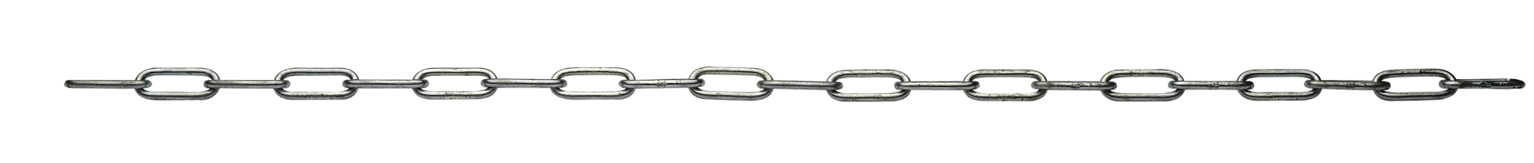
Value chain modeling
Chain of processes an organization performs to deliver value to customers and stakeholders
More generally, a mechanism to group high-level business processes according to an order relation (can be applied to core, support and management processes)
business process
Procure-to-service
order relation

Slide 45
Guidelines to identify horizontal boundaries in value chains
Change of key business object in the process
Change of granularity of main business object
Change in frequency/time
Change in intermediate outcome/resolution/objective

Slide 46
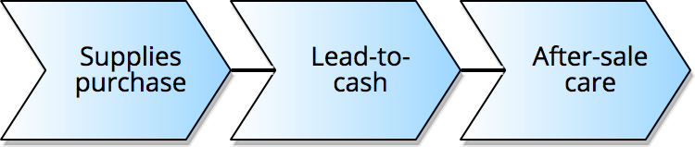
Example: value chain
Wholesaler
Core processes

Slide 47
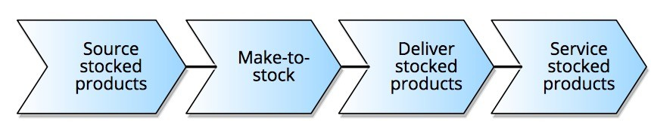
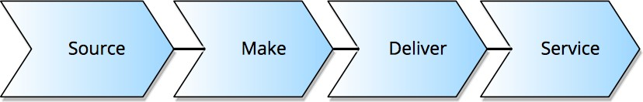
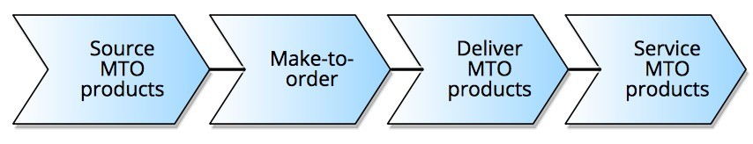
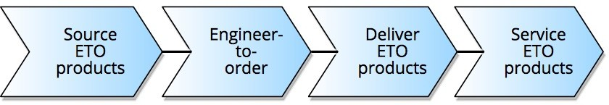
Typical value chains for core processes
Think around three main steps:
Imagine it (design new product/service)
Build it (source, assemble, deliver product/service)
Sell it (market, sell, service product/service)
Stocked
Products:
MTO
products:
ETO
products:
ucer
Specializations

Slide 48
Example: value chains for service provider
IT service provider
Design
Market
Sales
Deliver
Service
Systems Integration
Outsourcing Network Services
Enterprise Server Technology

Slide 49
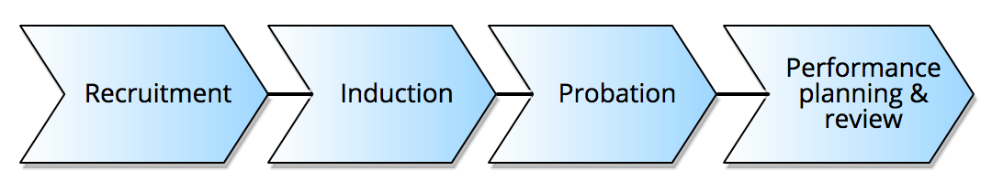
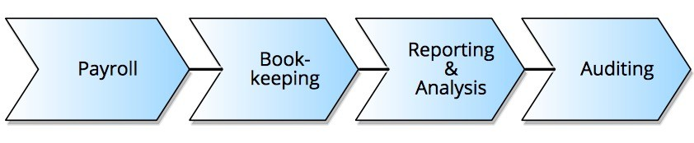
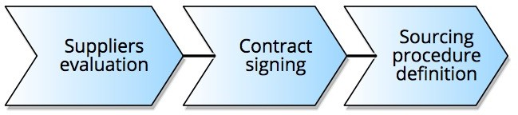
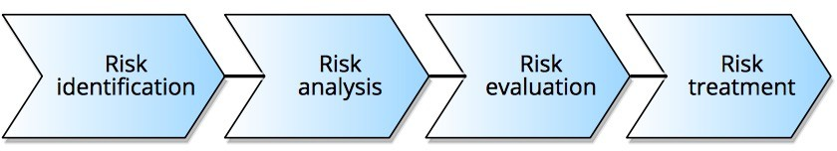
Example: value chain of non-core processes
Support processes
HR:
Accounting:
Management processes Suppliers
management:
Risk management:

Slide 50
Example: process architecture & value chains
Wholesaler
Strategic Management
Warehouse
Logistics
Management
Management
Suppliers
Management
Demand
Management
Management processes
Chevron: collapsed value chain
Box: groups processes/
Direct
procurement
Sales
Distribution
Procure-to-Service
Marketing
Service
Core processes
value chains
Finance
Indirect
procurement
IT
HR
Support processes

Slide 51
Alternative: process architecture – groups
Consultancy Firm
Manage Firm
1.3
(Re)design Processes
Management
processes
1.1
Plan the Business
1.2
Govern the Business
1.4
Develop Methods
& Standards
1.5
Change the Business
Expanded process group
Relate to Clients
2.3
Raise Awareness
Core
processes
2.1
Optimize Stakeholder Relationships
2.2
Develop
2.12
Evaluate Client
Solution Delivery
Service Offerings of Services
Optimize Portfolio
Deliver Solutions
2.7
Deliver Business System Solutions
2.4
Plan Delivery of Service to Service Corp.
2.5
Gain Initiative Commitment
2.13
Adjust Portfolio
2.6
Deliver Infrastructure Solutions
2.8
Provide Professional Services
Optimize Solutions
2.9
Operate Infrastructure & Business Systems
2.10
Retire Solutions
2.11
Support Users
Support Firm
Support
processes
3.1
Provide Expert Advice & Knowledge
3.2
Provide HR
Capabilities
3.3
Provide IT Tools
3.4
Acquire Goods &
Services
3.5
Obtain Financial
Services
3.6
Provide Working
Facilities

Slide 52
Typical artifacts for vertical scoping
Value chains
Chains of processes. Stay at a high level. Rule of thumb: 3-7 processes
Procure-to-service, Risk management
(Root/Main) Processes
Build up value chains and affect each other. They are abstract
Lead-to-quote, Quote-to-order, Order-to-cash
Subprocesses
Typical focus of Process enumeration
Build up processes. They are detailed, involve multiple activities and can be layered on different levels of abstraction (i.e. sub-subprocesses)
Order shipment, invoicing
Process tasks
Build up processes and sub-processes. They are atomic and performed by human beings, IT systems or equipment
Approve invoice

Slide 53
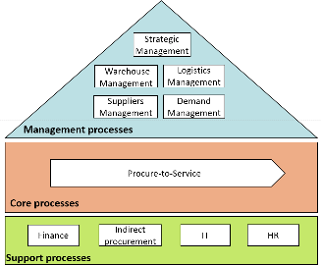
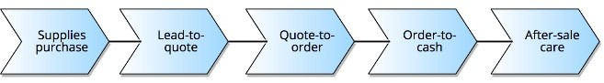
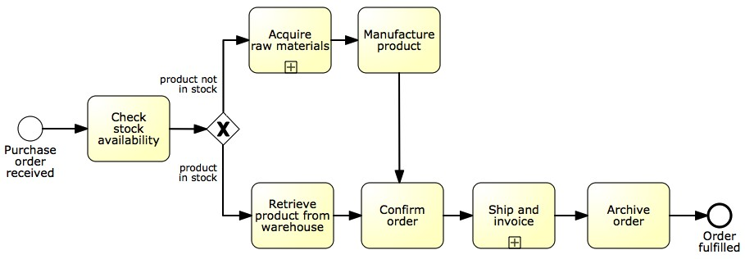
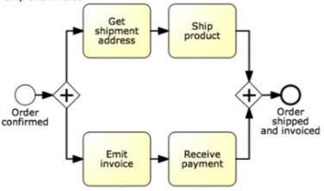
Process architecture: hierarchical view
Level 1
Process
Landscape
Level 2
Main Processes
(e.g. BPMN)
Level 3+ Subprocesses, Tasks (e.g. BPMN)
Process hierarchy

Slide 54

How many levels in the process architecture?
61

Slide 55
Example: hierarchical process architecture
Insurance company
Level 1
Strategic Management
Corporate
Development
Market
Development
Investor
Relations
Management processes
Risk Assessment & Management
Marketing & Sales
Underwriting
Policy
Servicing
Claims
Management
Management
Payments Collection and Disbursement
Assets Management
Core processes
Finance/
Legal/
Audit
Reinsurance
IT
HR
Treasury
Support processes

Slide 56
Example: hierarchical process architecture
Insurance company
Level 2
Strategic Management
Corporate development
Marketing development
Investor relations
Process group
Define business concept &
long-term vision
Design & manage corporate policies
Define offering and customer value proposition
Plan investor relations
Develop business strategy
Manage knowledge
Define pricing strategy
Build investor relations
Process subgroup
Manage strategic initiatives
Manage change & improvement
Define and manage channel strategy
Manage investor relations
Manage partners
Communicate with stakeholders
Manage investments & divestments
Management processes

Slide 57
Example: hierarchical process architecture
Develop business strategy
Define offering and customer value proposition
Process subgroup
Insurance company
Develop overall mission statement
Define offering and positioning
Evaluate strategic options
Main process
Develop value proposition
Level 3
Select
long-term business strategy
Validate value proposition
Coordinate functional and
operational strategies
Develop new branding
Align functional and
operational strategies
Create organisational design
Develop organisational goals
Formulate business unit strategies
Management processes

Slide 58
Example: hierarchical process architecture
Insurance company
Level 4
Develop overall mission statement
Main process
Define current business
Formulate mission
Subprocess
Communicate mission
Management processes

Slide 59
Designation via reference models
A reference model is used as a template to design the process architecture
Examples:
Information Technology Infrastructure Library (ITIL)
Supply Chain Operations Reference Model (SCOR)
Process Classification Framework (PCF)
Control Objectives for Information Technology (COBIT)
Value Reference Model (VRM)
Voluntary Interindustry Commerce Solutions (VICS)
eTOM Business Process Framework
Performance Framework

Slide 60

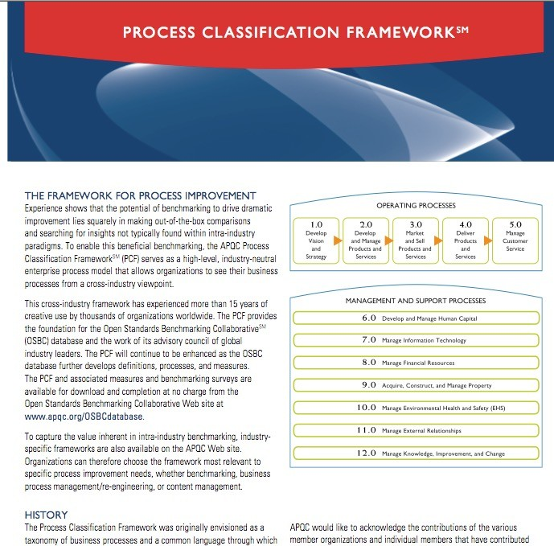
Example: APQC Process Classification Framework (PCF)
Industry-neutral enterprise model
Open standard for benchmarking
Four levels
Categories
Process group
Process
Activity

Slide 61
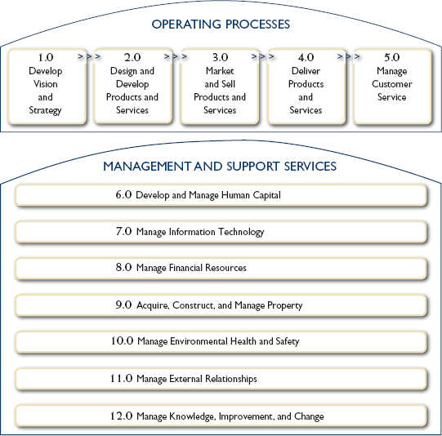
APQC PCF Overview
Category

Slide 62
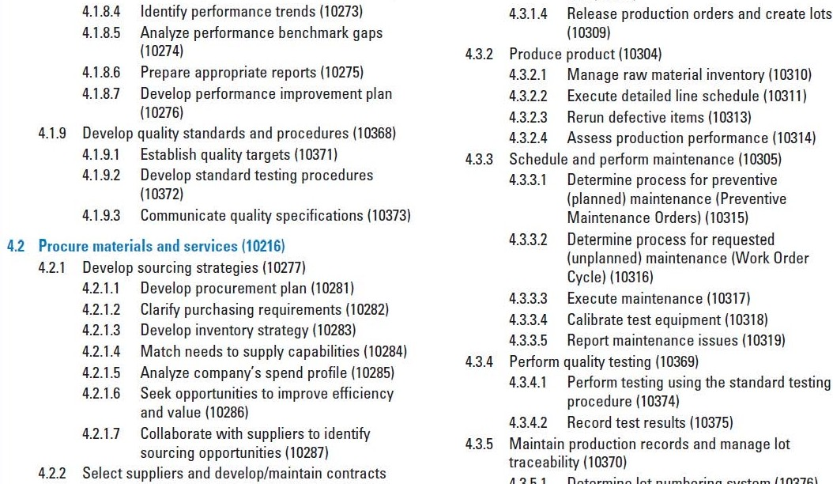
APQC Classification Framework
Group
Activity
Process

